Slide 1
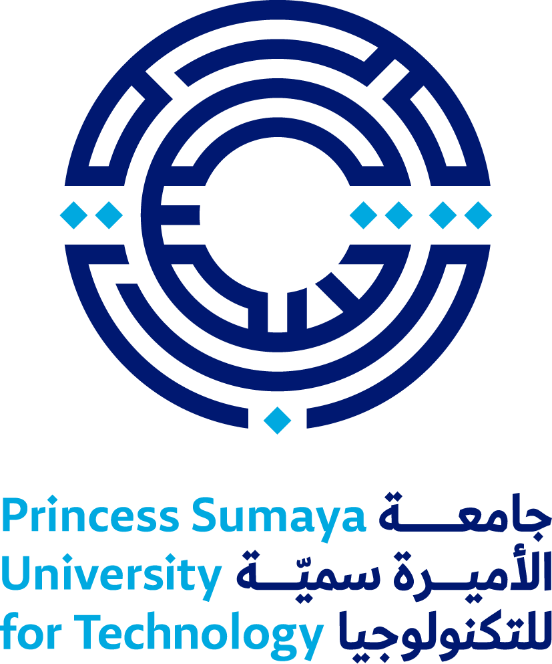
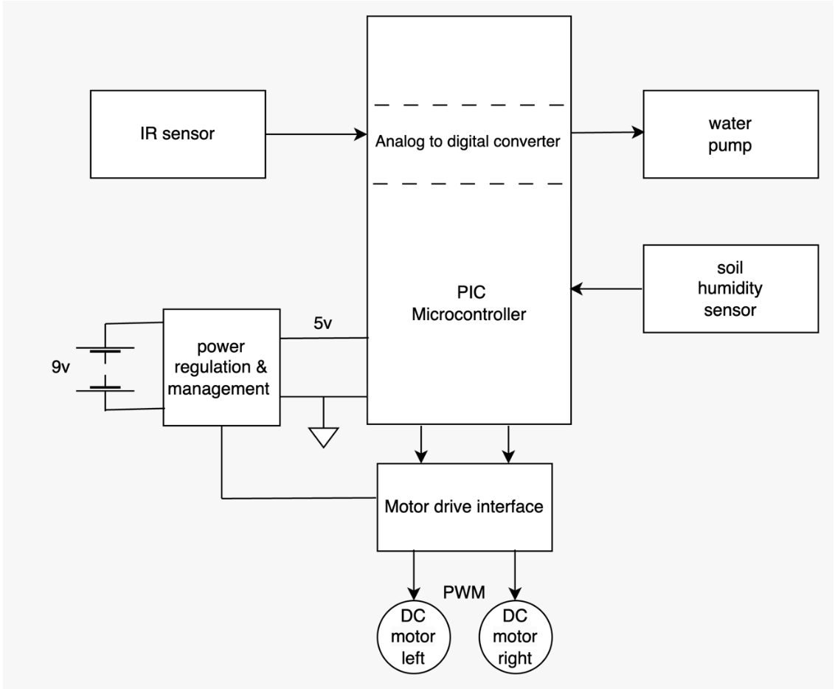
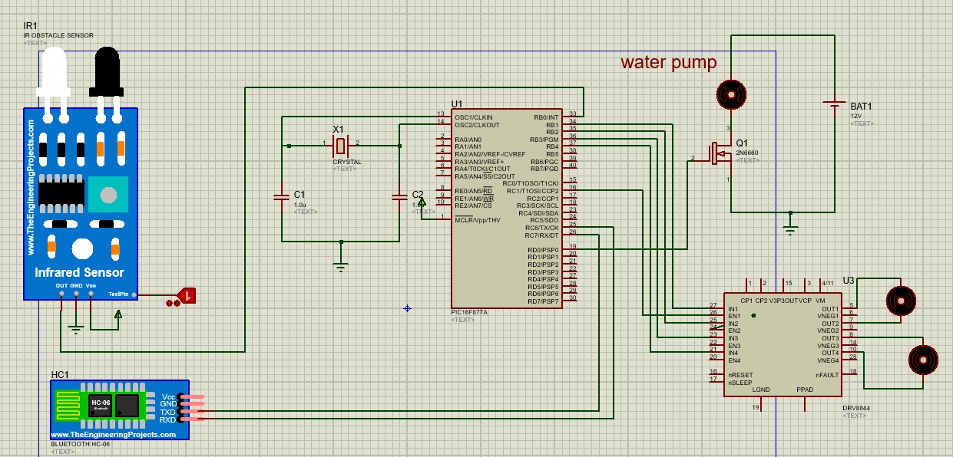
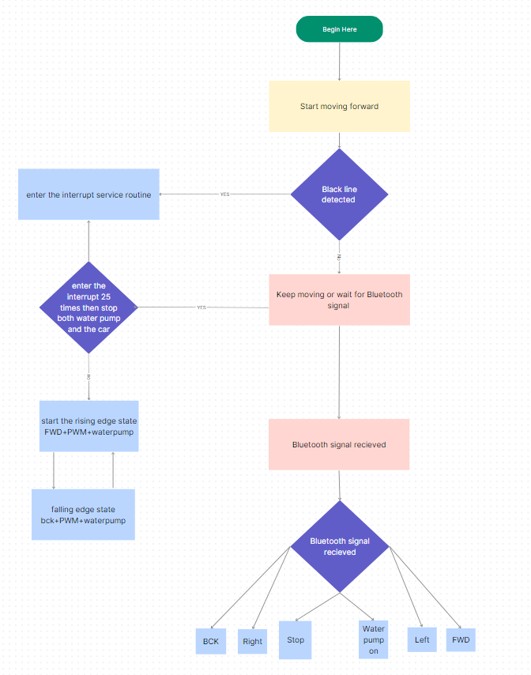
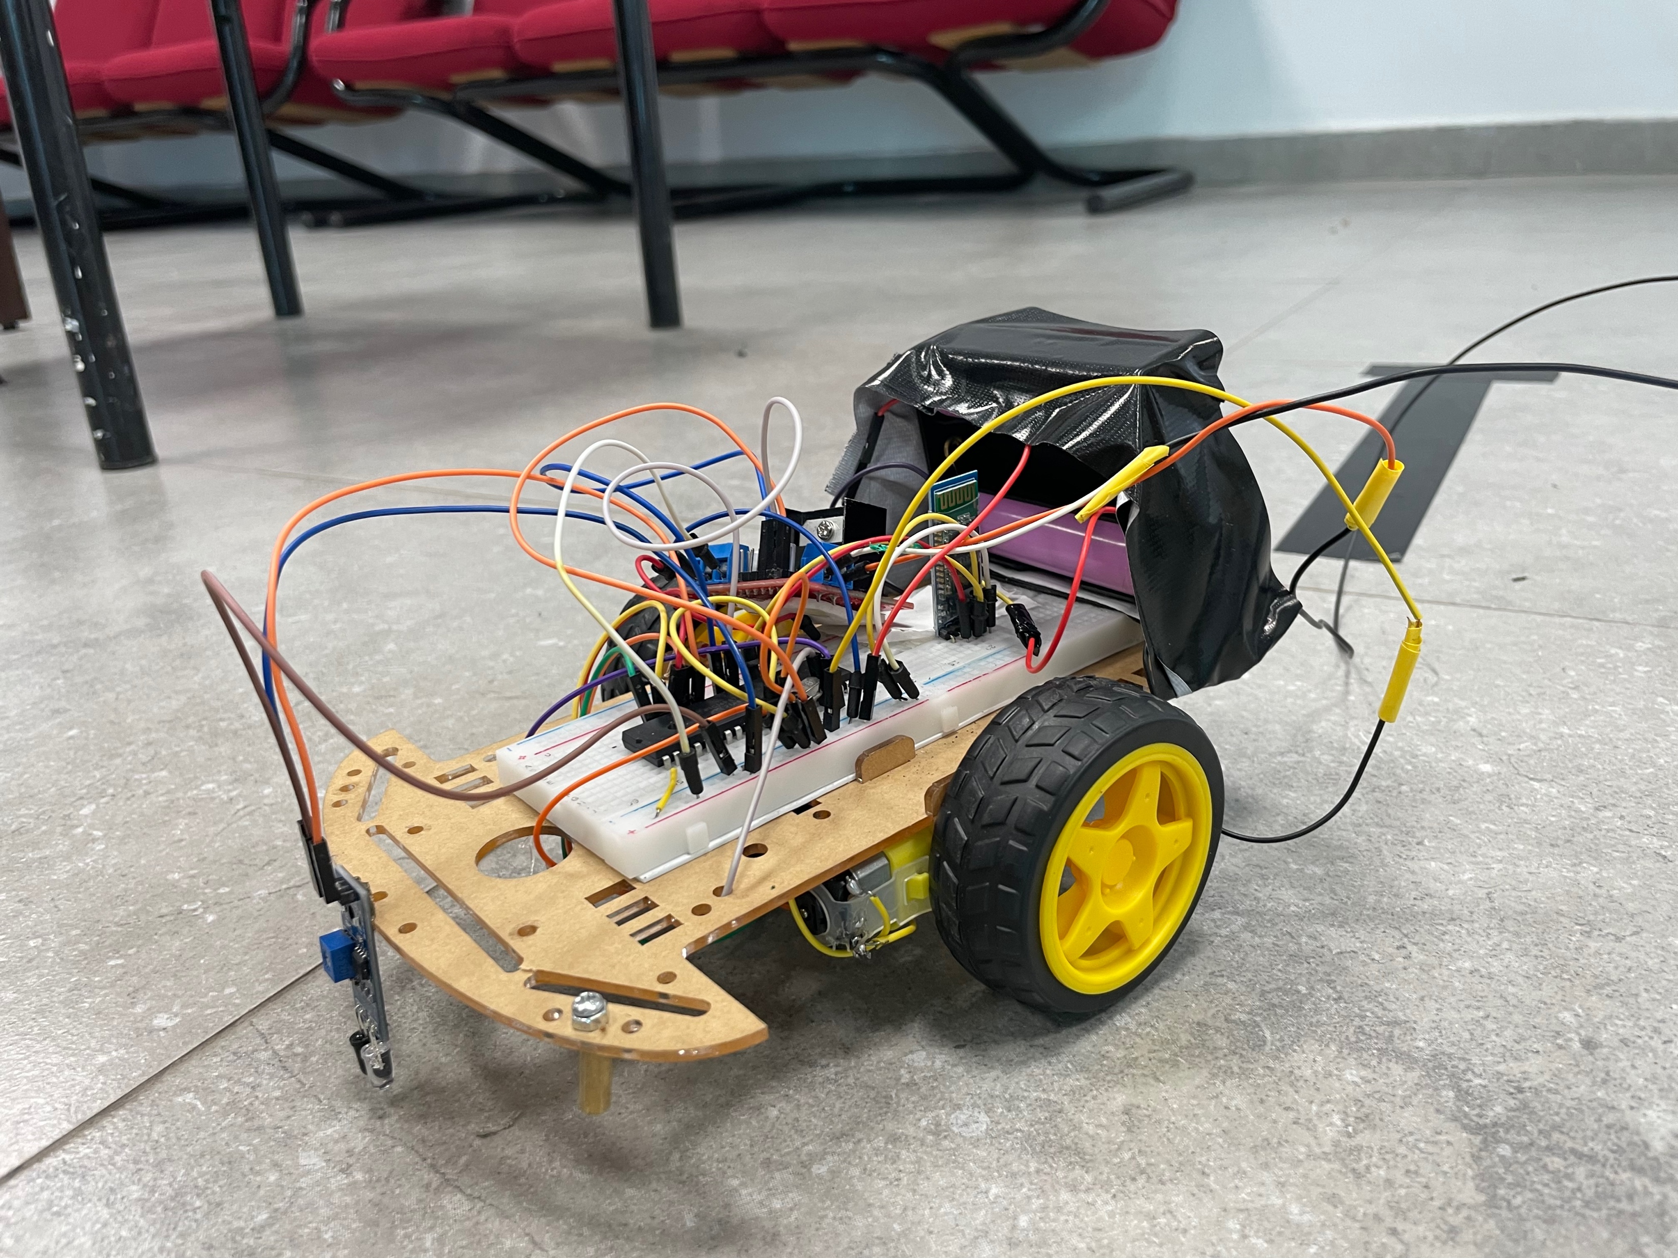
Plant Irrigation Vehicle
A. AlQawasmi, O. AlAtoum, M.AlSarabi
Supervisor: Dr. Belal Sababha Embedded Systems Final Design Project, Fall 2023 King Abdullah II School of Engineering
Princess Sumaya University for Technology
Introduction
Particularly in regions with little rainfall or inaccessible water sources, irrigation is essential for plant growth and crop production. On the other hand, conventional irrigation techniques like flooding or spraying can be ineffective and wasteful. In order to overcome these problems and advance sustainable agriculture, innovative plant irrigation methods have been created. One such option involves employing cars to distribute water directly to plants, which has the potential to be more accurate and effective than current procedures. This method is a crucial breakthrough for contemporary agriculture because it can aid in water conservation, decrease soil erosion, and increase crop yields.
Results
Figure 1: Car hardware design.
Figure 2: car Schematic.
Figure 3: Prototype.
Design
we will introduce an innovational solution for plant irrigation using a car that is equipped with many special equipment for the success of this project. The car operates in two ways, the first is by using line following sensor and water pump and the other way is by controlling the car using Bluetooth module and we use these methods to ensure high quality experience.
Using this project in the future will reduce the number of employees, the irrigation costs, the water consumption and will finish the tasks in less time.
We designed this car to move on a specific track to ensure that all the plants receive adequate amount of water. An IR sensor is used to determine the location of the car and to let the car move easily. Also, a Bluetooth module is used to have the access to adjust the schedule of irrigation and to control the car location.
In this report we will talk more about all the elements that we had used in our car to provide a efficient and convenient irrigation project.
Figure 1: Flow Chart
Conclusion
In conclusion, modern methods of irrigation for plants employing automobiles provide a number of advantages over older ones. It is possible to deliver water to plants more effectively and precisely by using vehicles outfitted with specialized equipment, which may lead to higher crop yields and less water consumption. This strategy also lowers labor costs and limits the harm that large machinery causes to crops.

